Slide 1
THE LONG, BLOODY BIRTH OF THE CHINESE EMPIRE
New Lessons for the Son of Heaven

Slide 2
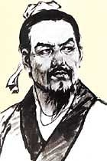
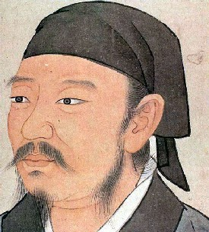
The Legalists
Xunzi (300-237 BCE) Han Feizi (d. 233 BCE)
Sources: Internet Encyclopedia of Philosophy at http://www.iep.utm.edu/x/xunzi.htm and East-West Energy Chronicle at www.china-alberta.com/Graphics/hanfeizi.jpg

Slide 3
Xunzi (300-237 BCE)
Confucian thinker that differed greatly with Mencius regarding his understanding of human nature
Little innate goodness in people
Li (ritual) refers to external standards imposed on the common people by sage kings

Slide 4
Han Fei Zi (d. 233 BCE)
Founder of the Legalist School
Ruler as semi-divine figure
All social activity focused on strengthening the economy and military of the state

Slide 5
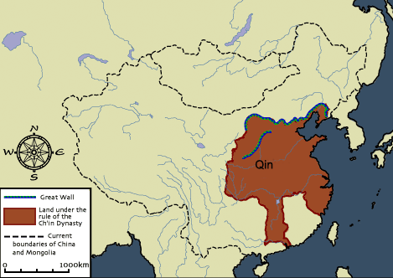
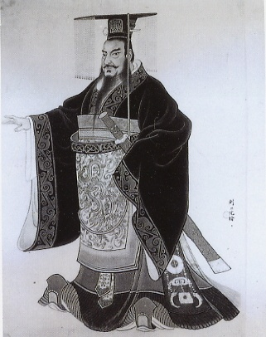
China’s First Empire: Qin Dynasty (221-206 BCE)

Slide 6
Qin Shi Huang Di (d. 210 BCE)
Final ruler of the Qin Kingdom and first emperor of China.
Erased the boundaries of the warring kingdoms and reorganized China into a system of Jun (commandaries).
Chose for himself a new political title “emperor” with the following elements: huang: “great one,” di: “emperor” (title once used for the Shang diety), shi: “number one”
Connected section of existing walls along the northern frontier to create the “Great Wall” to hold off the Xiongnu, which were the nomadic peoples living to the north and northwest of “settled” China.

